Slide 1
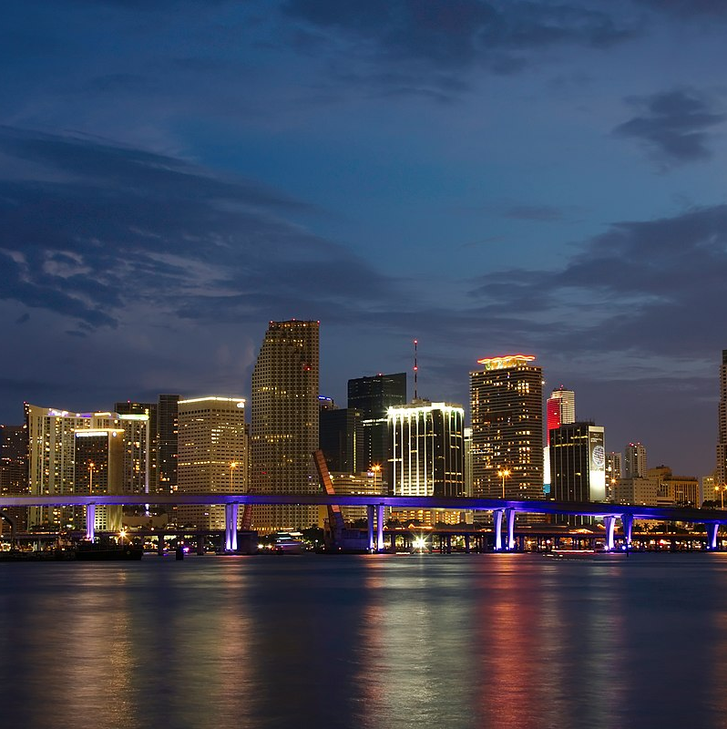

Florida USPS Contacts

Slide 2

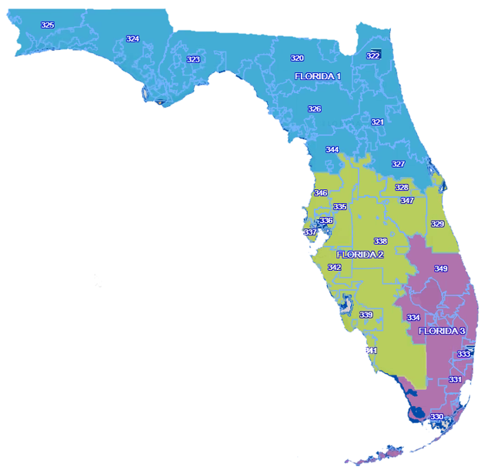
Tool Automation
2022 | Florida USPS Contacts
FL-1
(Jacksonville)
320-327, 344
District Manager
FL-2
(Tampa)
328-329, 335-339, 341-342, 346-347
District Manager,
FL-3
(Ft. Lauderdale / Miami)
330-334,
349
District Manager
GeorgAnne Casteel, (813) 243-5960; Georganne.casteel@usps.gov
Seneca Lucas, (904) 645-3220; Seneca.Lucas@usps.gov
Mary Ann Palacios, (954) 527-3271; Mary.A.Palacios@usps.gov
Wendy English (A): (904) 359-2931; Wendy.L.English@usps.gov
Debra Stoops, (904) 359-2711; Debra.S.Stoops@usps.gov
Richard Fermo(A): (813) 354-6099; Richard.Fermo@usps.gov
Customer Relations Manager
Carol Shirley, (813) 354-6064; carol.j.shirley@usps.gov
Business Mail Entry Contact
Michael Vecchitto(A): michael.v.vecchitto@usps.gov, (954) 527-6987
Customer Relations Manager
Joycelynn King, (954) 527-3261; Joycelynn.King@usps.gov
Business Mail Entry Contact
Customer Relations Manager
Business Mail Entry Contact
ALA, BAK, BAY, BRA, BRE, CAL, CIT, CLA, CLM, DIX, DUV, ESC, FLA, FRA, GAD, GIL, GUL, HAM, HOL, JAC, JEF, LAF, LAKE, LEO, LEV, LIB, MAD, MRN, NAS, OKA, PUT, STJ, SAN, SEM, SUW, TAY, UNI, VOL, WAK, WAL, WAS
CHA, COL, DES, HAR, HEN, HER, HIG, HIL, IND, LEE, MAN, ORA, OSC, PAS, PIN, POL, SAR, SUM
BRO, GLA, MAR, MIA, MON, OK, PAL, STL

Slide 3

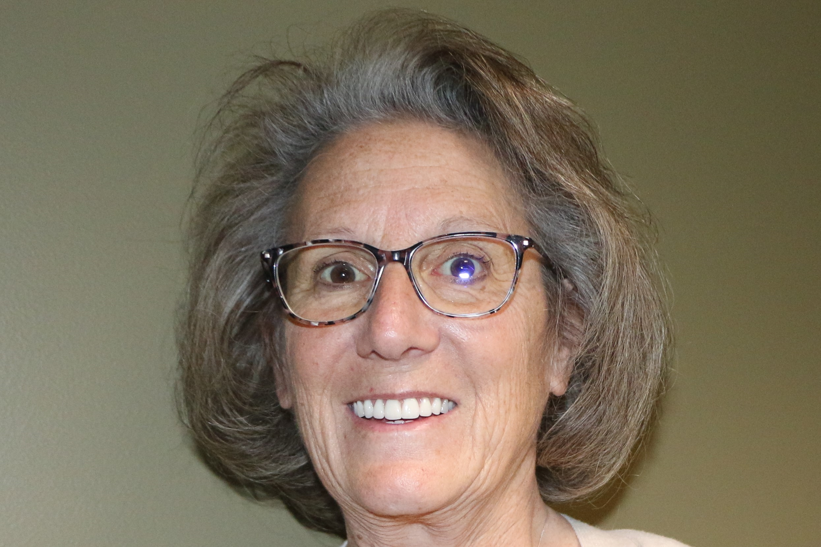

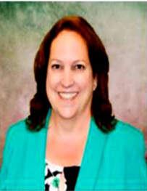
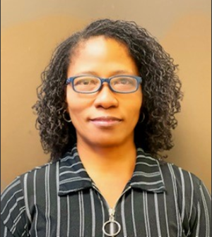
Contact your Customer Relations Managers
This election season, the Postal Service has designated a single point of contact for Election Mail planning, questions, and issue resolution. Your point of contact is supported by a nation-wide team of dedicated postal employees who are deeply knowledgeable about and fully committed to the timely delivery of Election Mail.
Debbie Stoops, FL 1 Manager Customer Relations
Phone: (904) 359-2711
Email: Debra.S.Stoops@usps.gov
Carol Shirley, FL 2 Manager Customer Relations
Phone: (813) 354-6064
Email: Carol.J.Shirley@usps.gov
Joycelynn King, FL 3 Manager Customer Relations
Phone: (954) 527-3261
Email: Joycelynn.king@usps.gov

